Slide 1


Understanding Immigration in Canada: A Data-Driven Perspective
Adam Miszkiewicz
200547405

Slide 2
Overview
Introduction
Data
Conclusion

Slide 3
Introduction
Who are Canada’s immigrants?
Where do they come from?
Where do they go?
What are the gaps?

Slide 4

Disclaimer:
Please note that in these datasets, the figures have been suppressed or rounded to prevent the identification of individuals when the datasets are compiled and compared with other publicly available statistics. Values between 0 and 5 are shown as “--“ and all other values are rounded to the nearest multiple of 5. This may result to the sum of the figures not equating to the totals indicated.

Slide 5

Datasets Used
https://open.canada.ca/data/en/dataset/f7e5498e-0ad8-4417-85c9-9b8aff9b9eda/resource/5582034d-8f89-49d5-8597-483d628078a1
https://open.canada.ca/data/en/dataset/f7e5498e-0ad8-4417-85c9-9b8aff9b9eda/resource/1a8171dc-292b-4209-a700-63cb699269ff
https://open.canada.ca/data/en/dataset/f7e5498e-0ad8-4417-85c9-9b8aff9b9eda/resource/2aa5b7eb-0418-4e2c-bf6e-be26ab547b5e
https://open.canada.ca/data/en/dataset/f7e5498e-0ad8-4417-85c9-9b8aff9b9eda/resource/ad5ccc07-0f12-4339-8850-91525cc5d13f

Slide 6
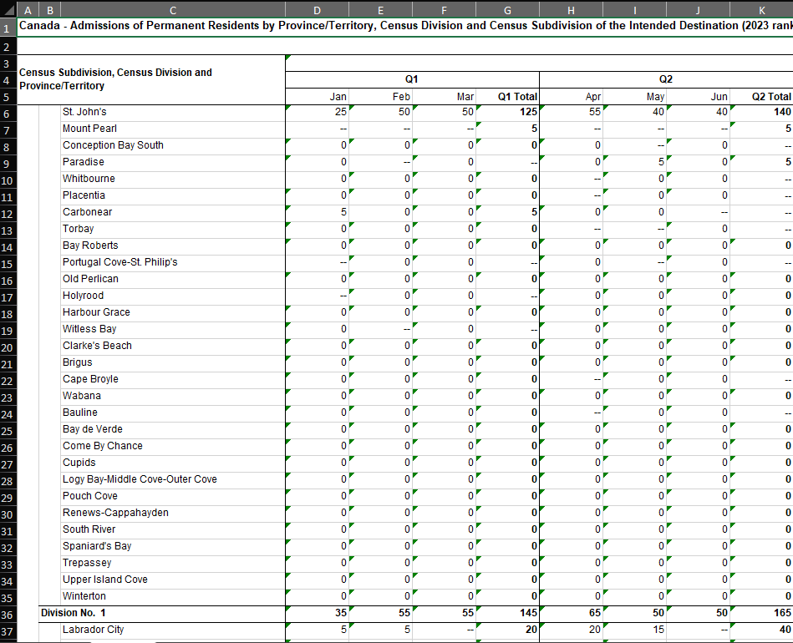
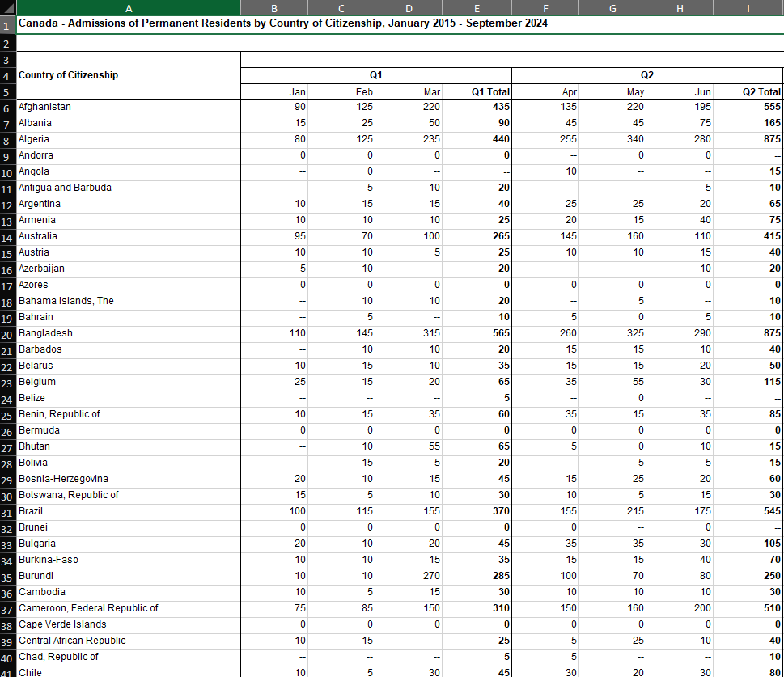
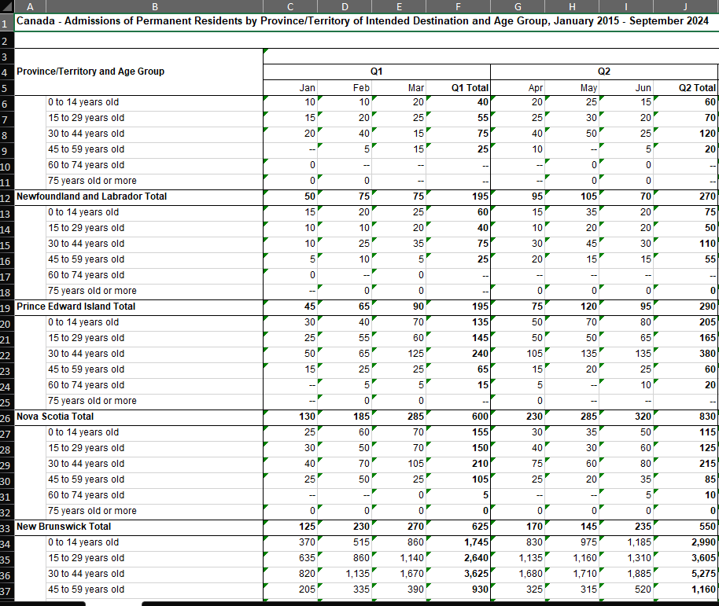
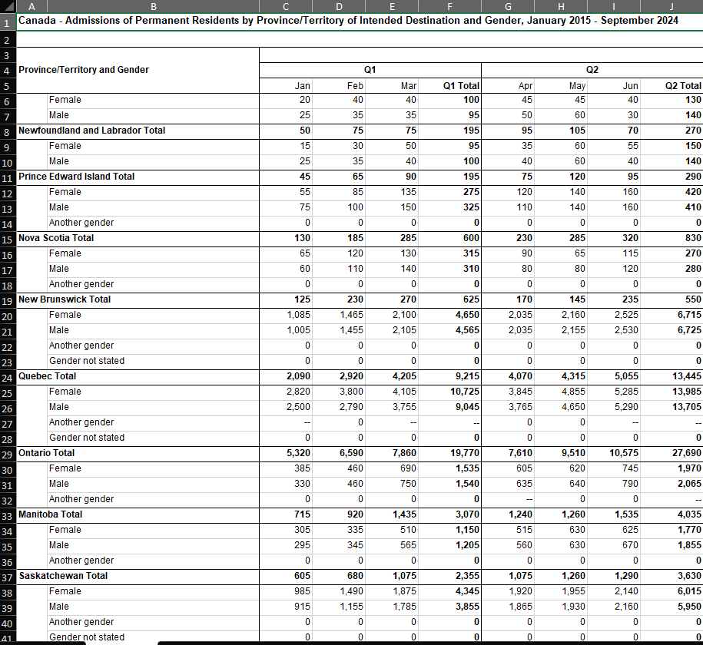
Raw Data

Slide 7

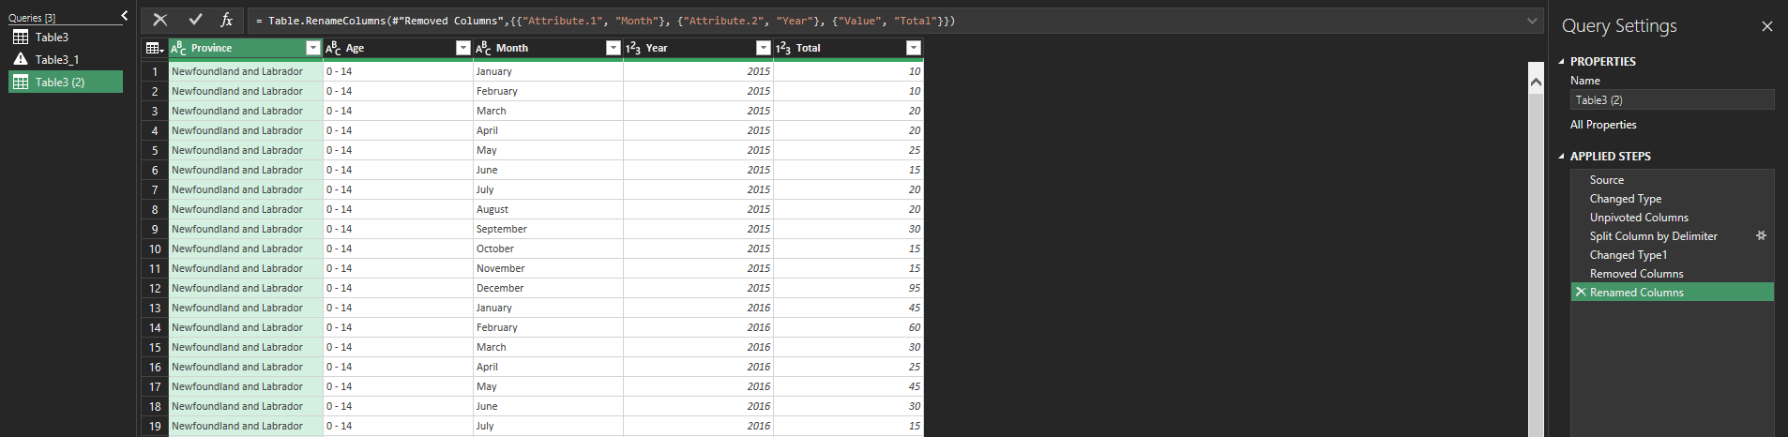
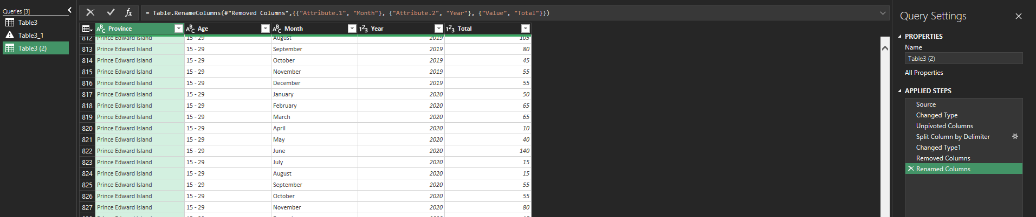
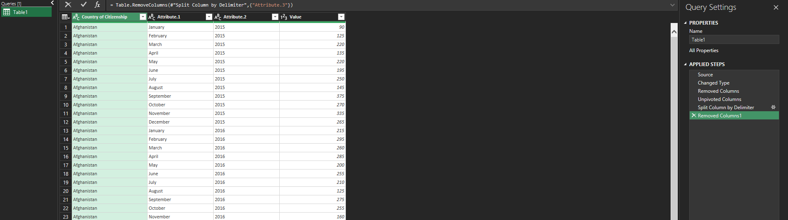
Cleansing Process

Slide 8
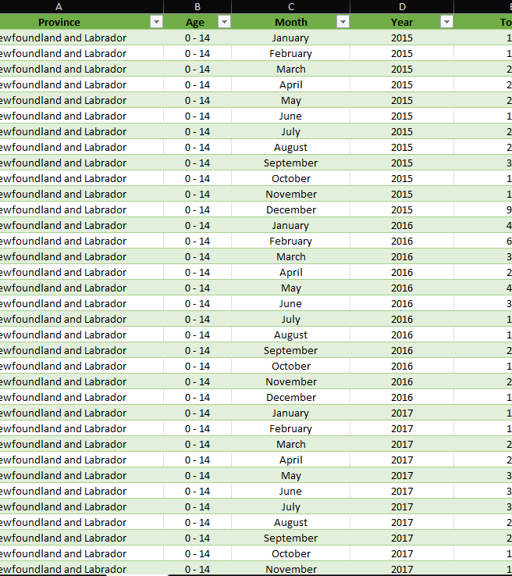
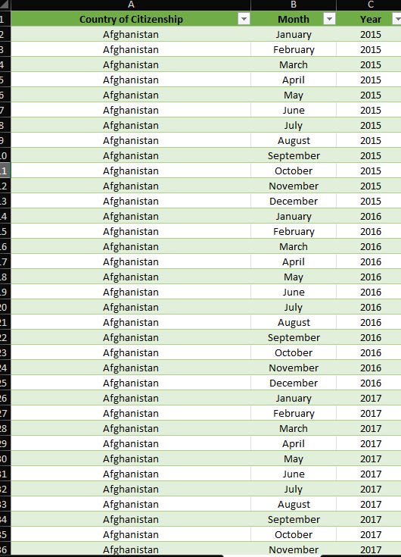
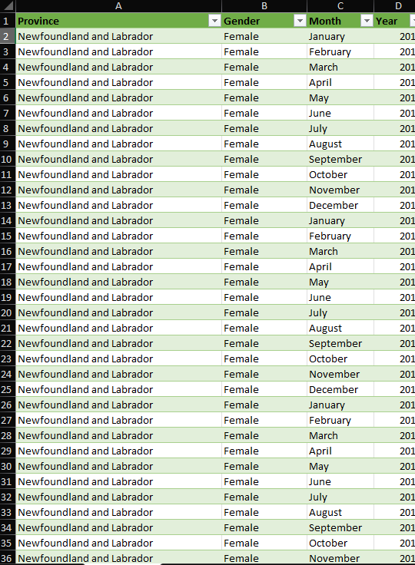
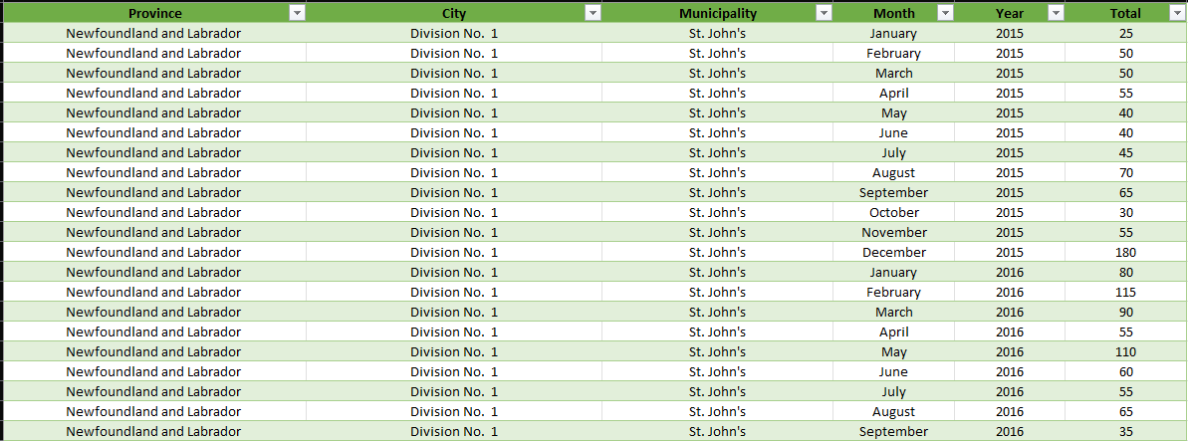
Cleansed Data

Slide 9
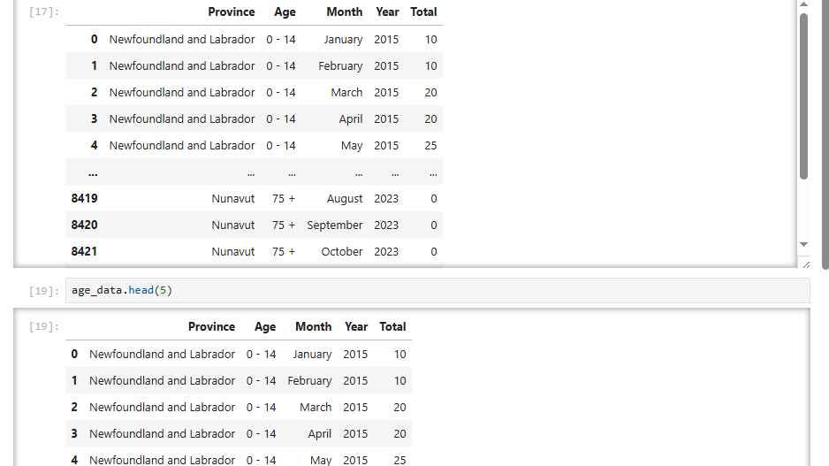
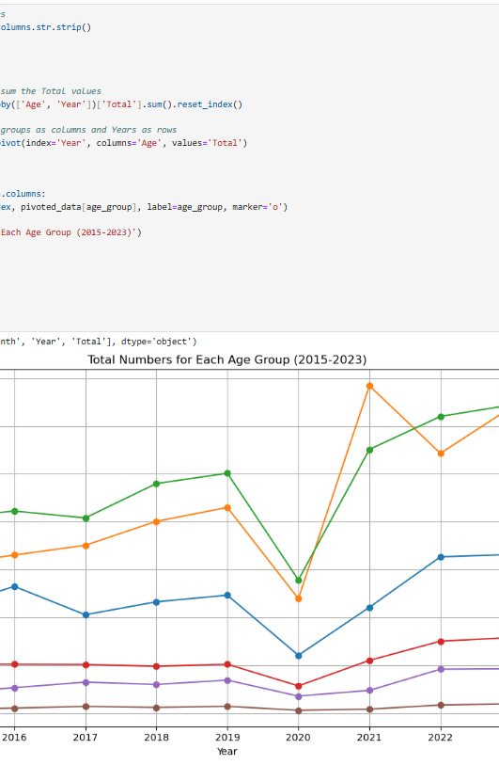
EDA Process

Slide 10
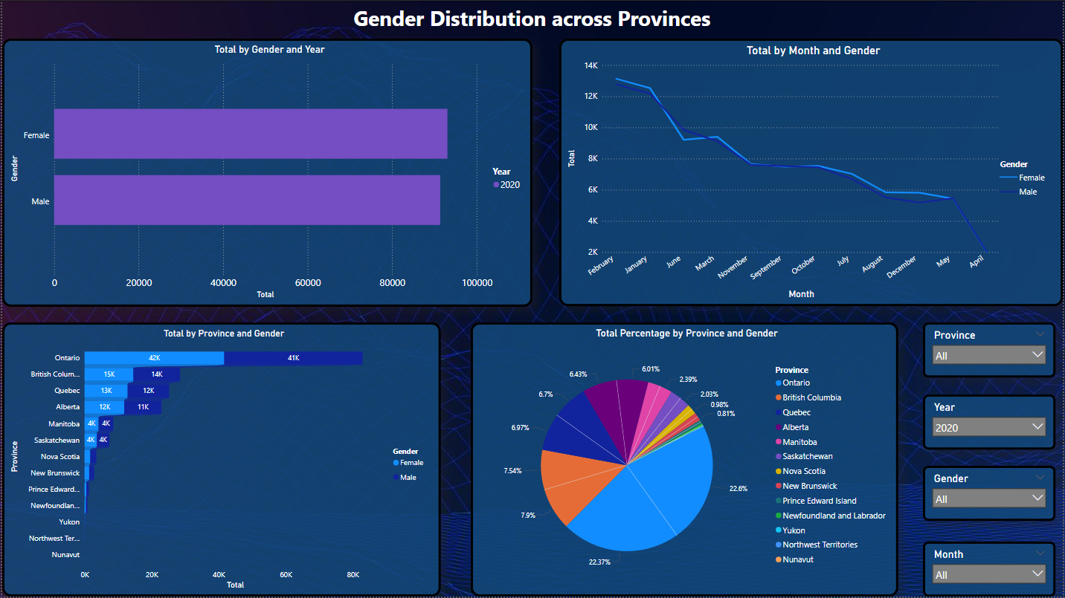
Dashboard 1: Gender Trends

Slide 11
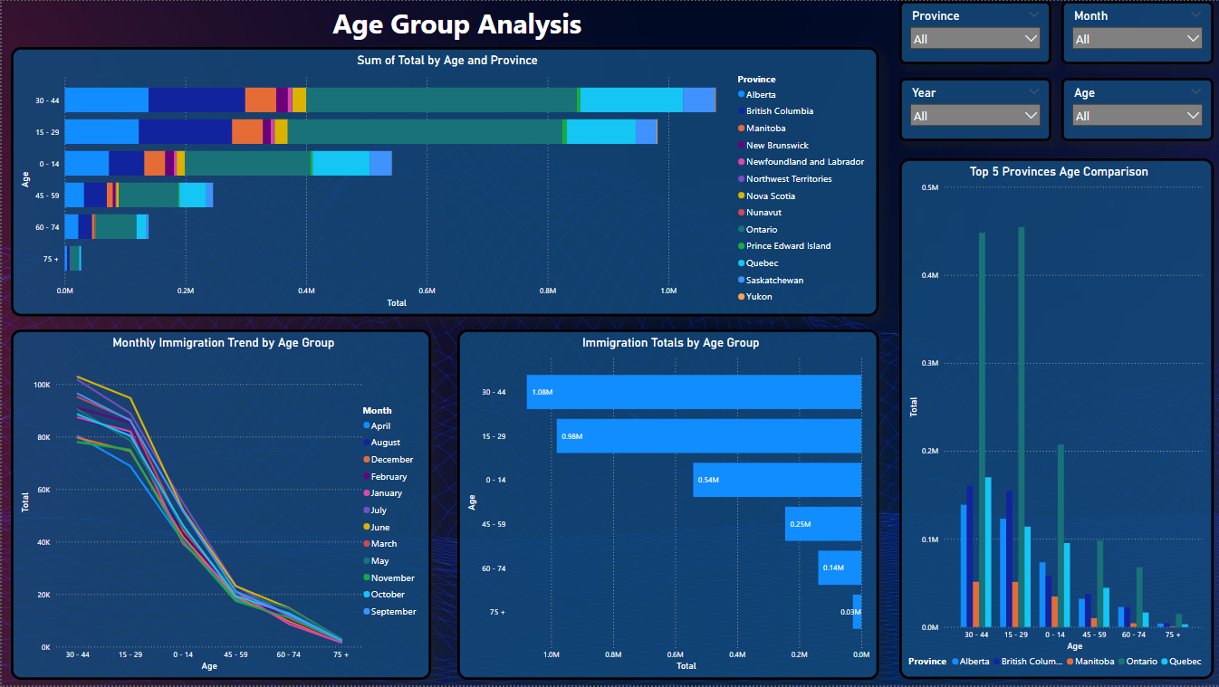
Dashboard 2: Age Group Analysis

Slide 12
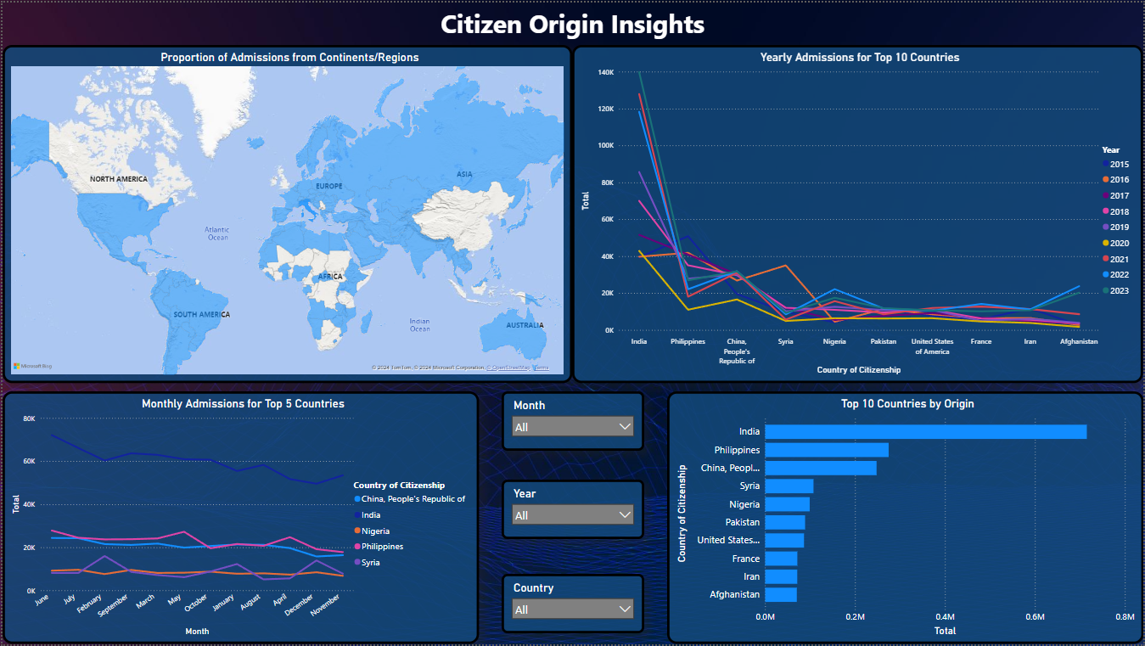
Dashboard 3: Citizen Origin Insights

Slide 13
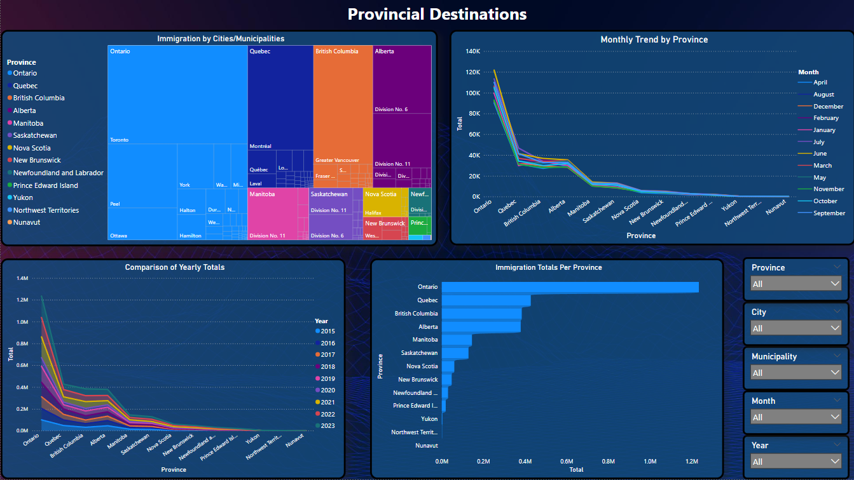
Dashboard 4: Provincial & Territorial Destinations

Slide 14
Conclusion & Key Takeaways
Gender Trends: Family reunification and caregiving categories drive higher female admissions, while labor-driven streams affect male admissions during economic downturns.
Age Trends: Young professionals dominate admissions, reflecting Canada’s focus on economic immigration, while older age group admissions are more vulnerable to external disruptions like the pandemic.
Country of Origin Insights: Immigration from India continues to grow due to skilled worker pathways, while global crises affect refugee admissions.
Provincial Destinations: Ontario and British Columbia remain dominant destinations, but smaller provinces are seeing gradual growth through regional initiatives.

